Slide 1
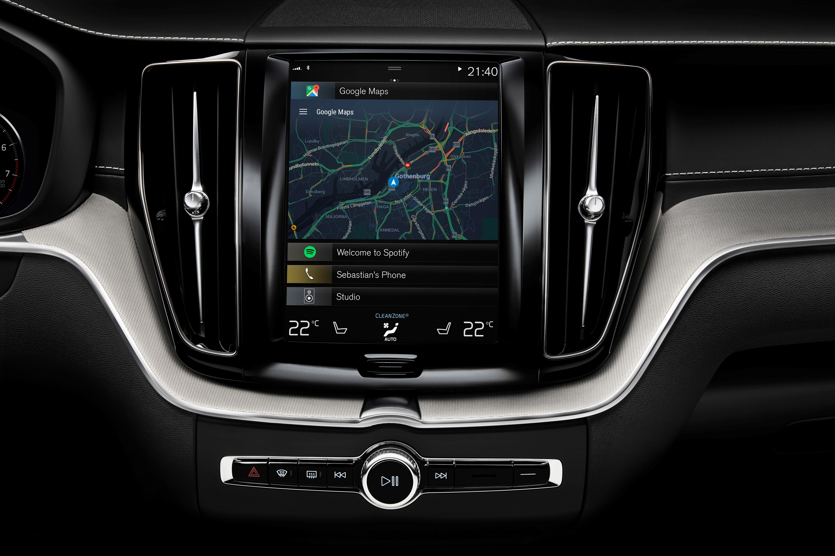

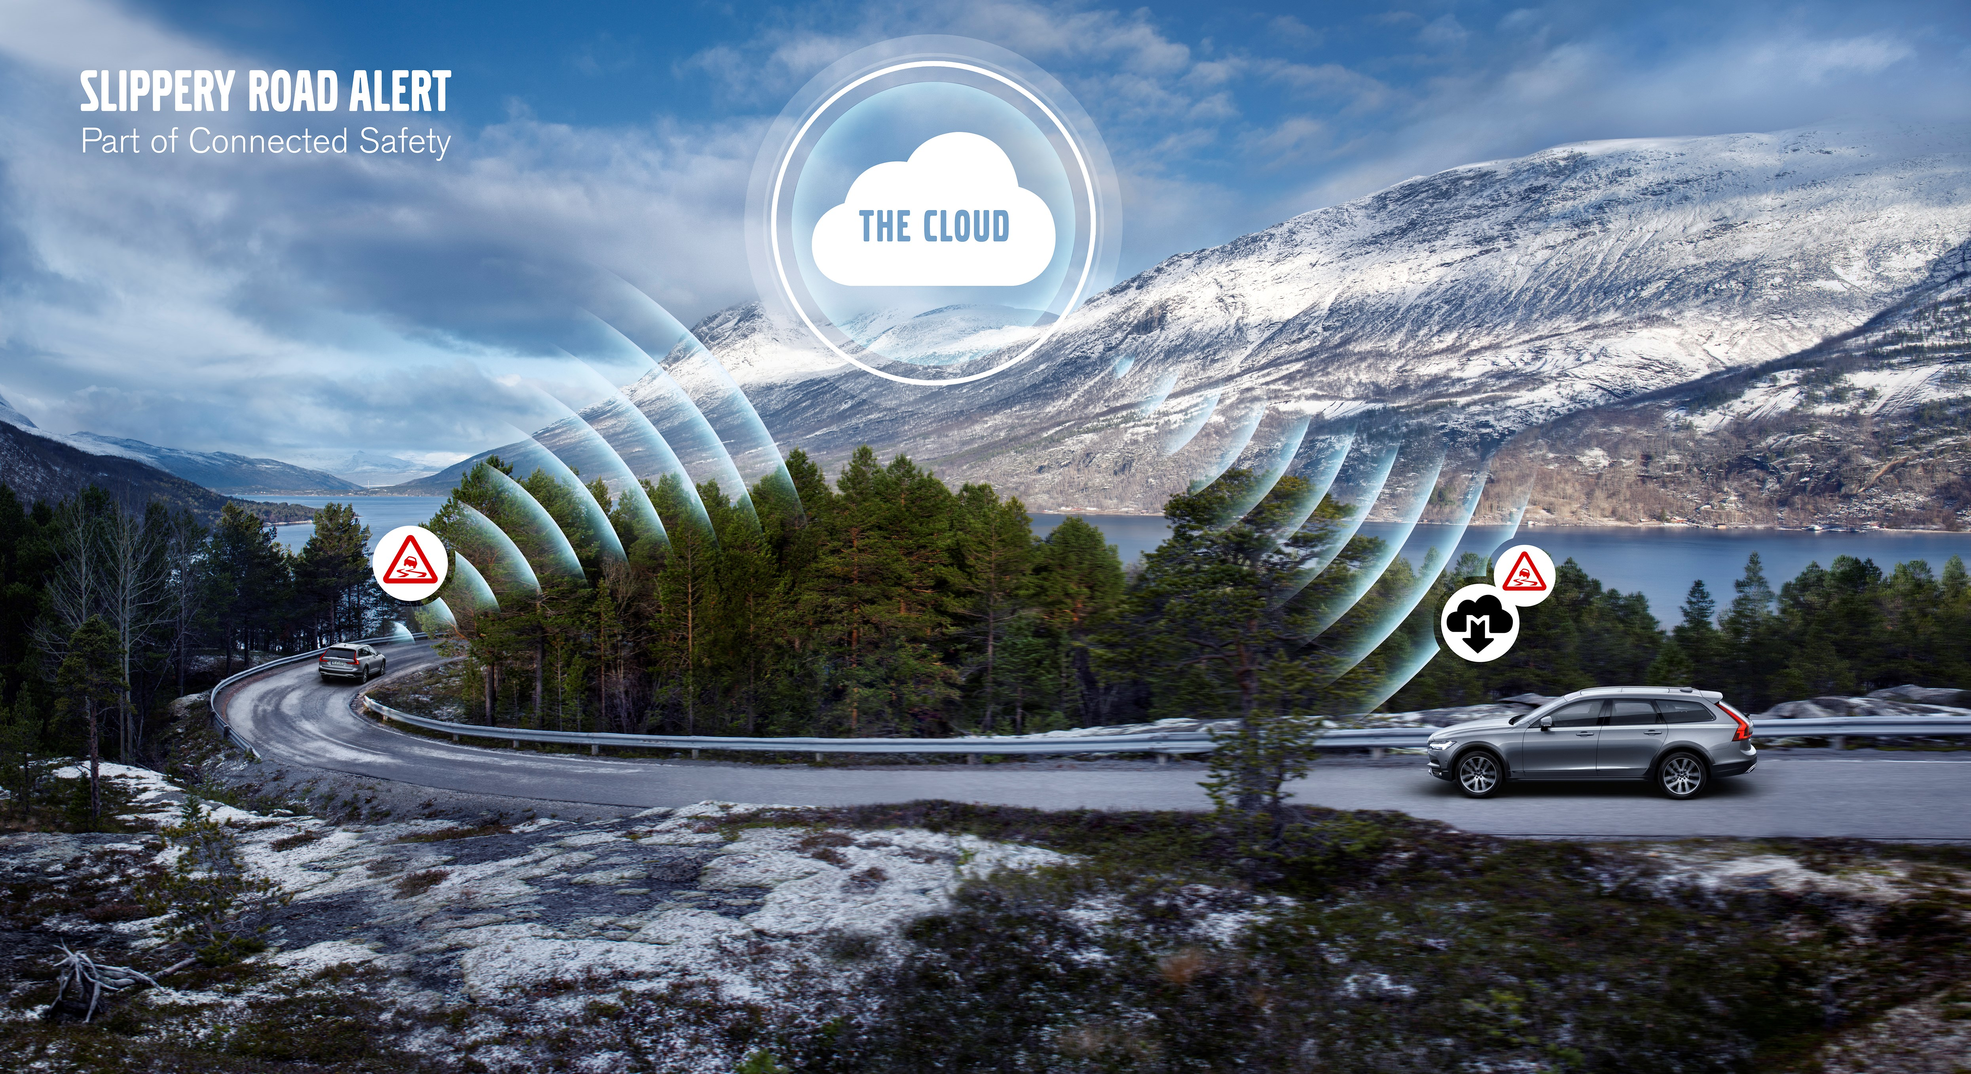
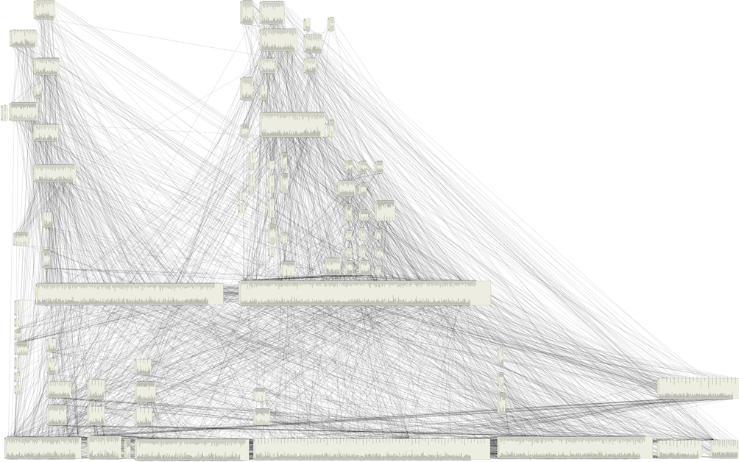
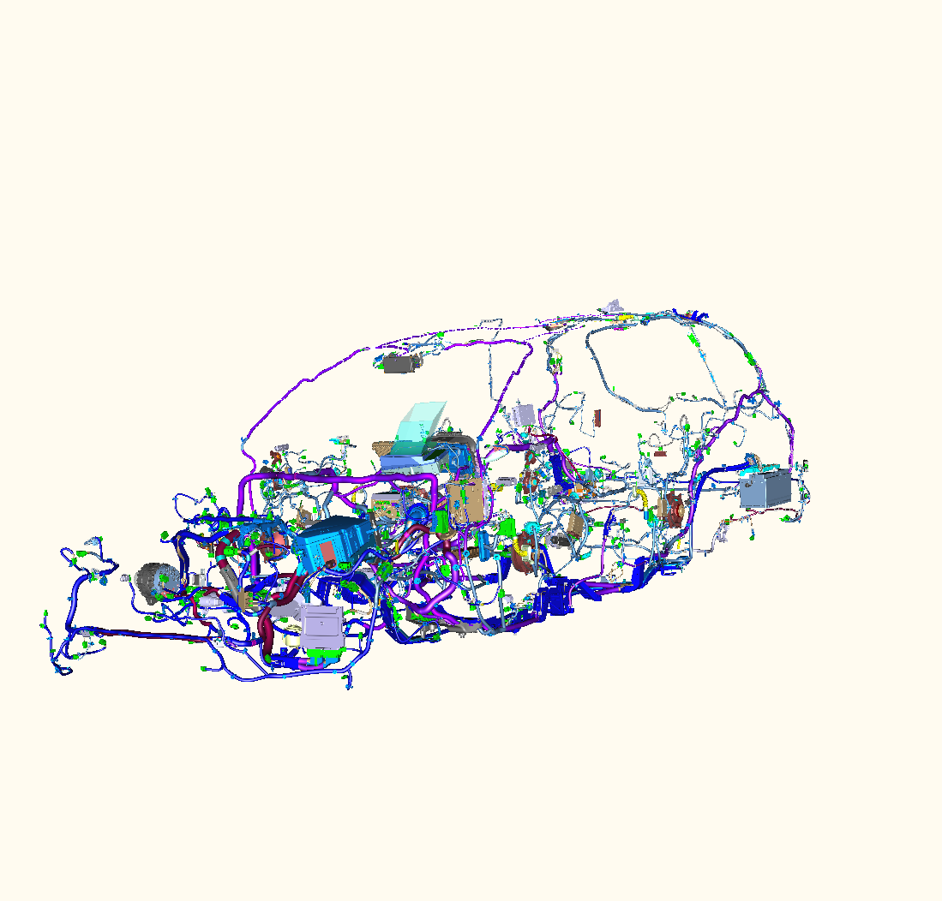
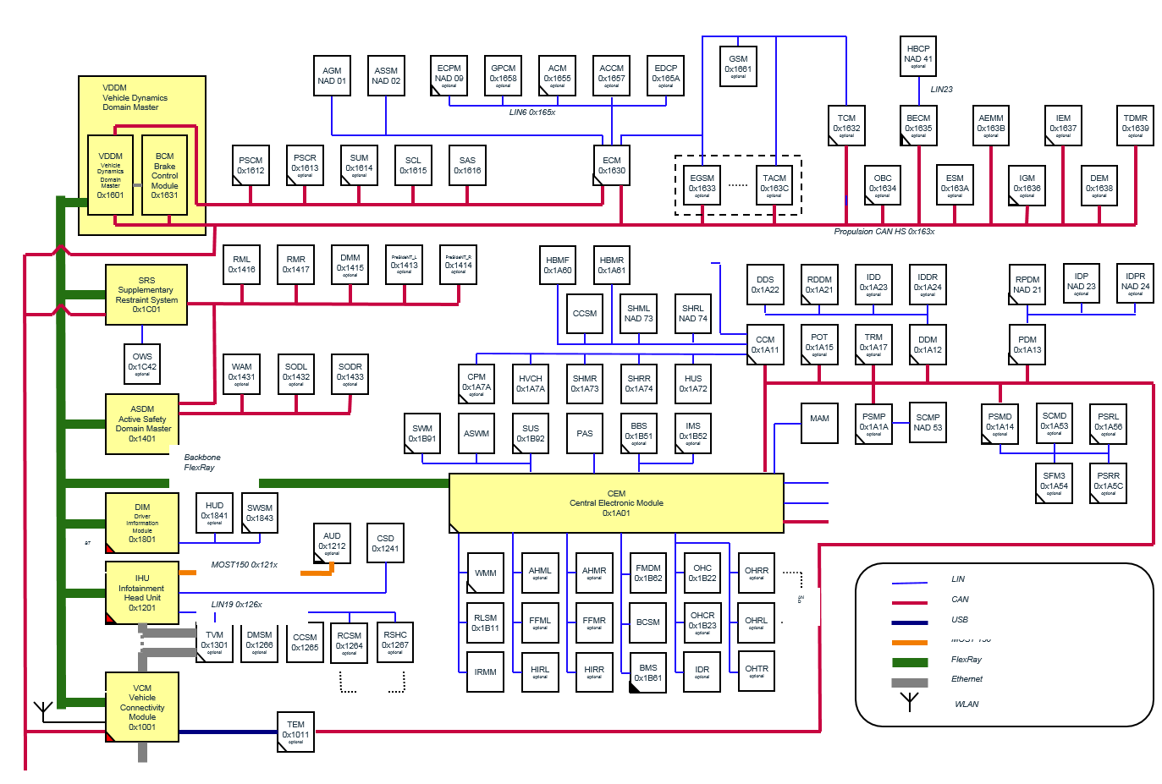
Software Complexity Awareness Vard Antinyan

Slide 2
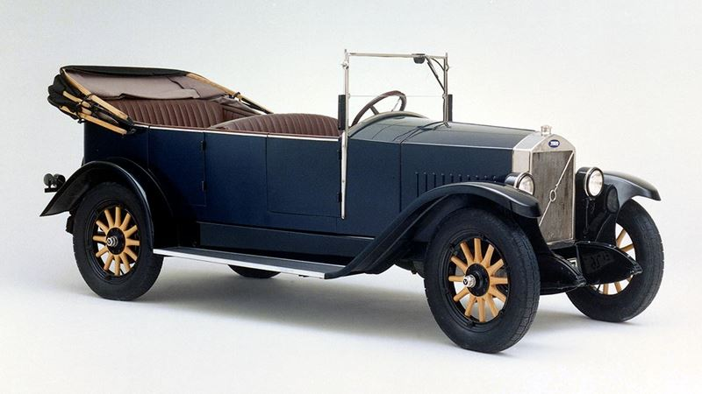
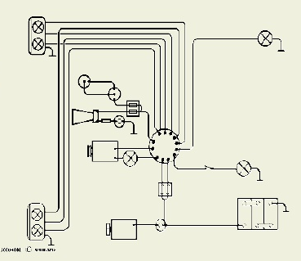
The beginning: 1927 Volvo
Taillights
Headlights
Horn
Battery

Slide 3
ECU count Evolution at Volvo
130
110
100
80
70
60
Number of ECUs
Over the past 25 years, the number of computers (ECUs) has grown from around 10 to more than 130.
50
40
20
10
1995
2000
2005
2010
2015
2020

Slide 4
Bus signal count evolution at Volvo
18 000
Over the past 20 years, the number of bus signals has grown from ~100 to ~15 000.
16 000
~15 000
14 000
12 000
10 000
Number of signals
8 000
~7000
6 000
4 000
~2700
2 000
~100
2000
2006
2015
2020
Notes:
Source: Martin Nilsson’s slide on SW size increase

Slide 5
Computerization of Vehicle
Million Lines of Code
1 000
Autonomous Drive
Advanced Collision Avoidance System
Adaptive Cruise Control
100
Exponential growth of code
10
Navigation Systems
Multiplexed networks
Adaptive Suspension
1
Traction Control
Integrated Powertrain Control
Cruise Control
0,1
Engine Control
Transmission control
Electronic Fuel Injection
0,01
Time
1980’s
1990’s
2000’s
2010’s
2020’s

Slide 6



What does Many Lines of Code mean?
Buck did no read the newspapers, or he would have known that ...
1 line of code (from propulsion code, Volvo)
1 line of text (from “the call of the wild”, Jack London)
Volvo 2000: 1 Million LOC
Volvo 2010: 10 Million LOC
Volvo 2020: 100 Million LOC
~60 Books
~600 Books
~6000 Books

Slide 7

What does Many Lines of Code mean?
Buck did no read the newspapers, or he would have known that ...
1 line of code (from propulsion code, Volvo)
1 line of text (from “the call of the wild”, Jack London)
Volvo 2030: 1 Billion LOC
How many logical and grammatical mistakes do you think there are in these books?
Equivalent to MIT Science Fiction Society Library
~60 000 Books

Slide 8
What is Software Complexity?
An emergent property of software due to increasing number of software elements and interconnections
Elements and Interconnections
Structural
Operator
Control statement
Variable
...
Representational
Line length
Indentation
Variable name
...
Evolutional
Modified lines of code over time
....
Reference
https://www.researchgate.net/publication/339377604_Evaluating_Essential_and_Accidental_Code_Complexity_Triggers_by_Practitioners'_Perception

Slide 9
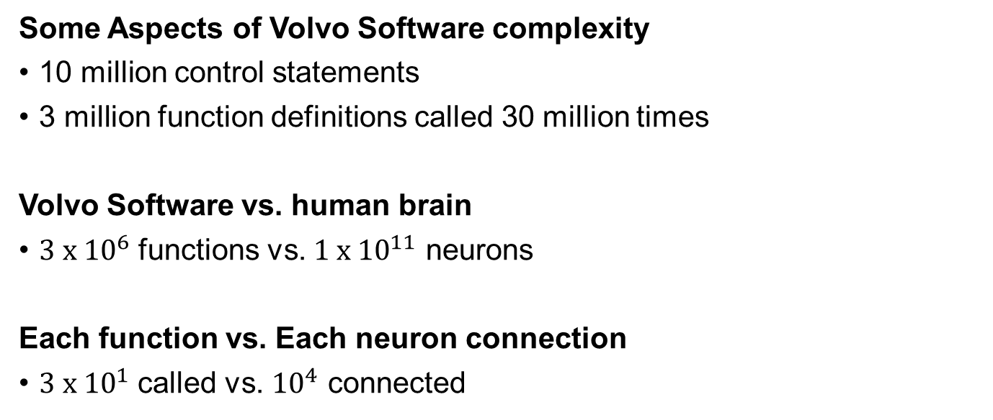
Volvo Software Complexity
Some Aspects of Volvo Software complexity
10 million control statements
3 million function definitions called 30 million times
Volvo Software vs. human brain
$3 x {10}^{6}$ functions vs. $1 x {10}^{11}$ neurons
Each function vs. Each neuron connection
$3 x {10}^{1}$ called vs. ${10}^{4}$ connected

Slide 10
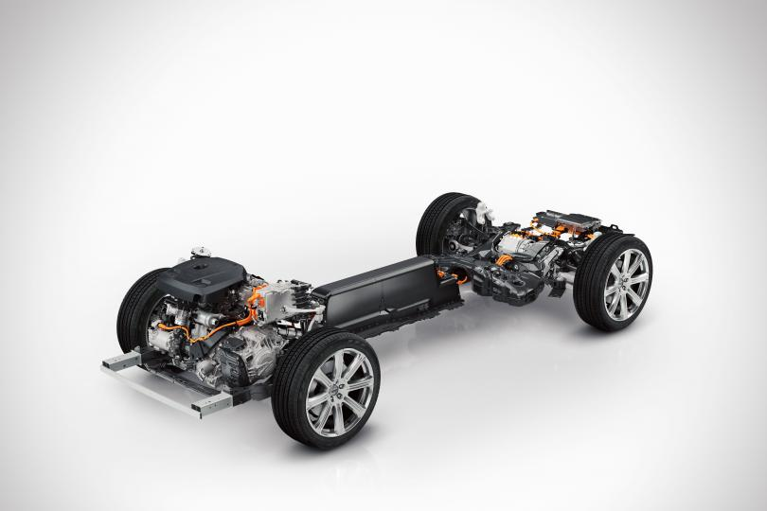
A Propulsion case
Code written by Volvo for Propulsion:
Electric Drive control: 160 000 Loc
Combustion Drive control: 800 000 Loc
Total 1 MLoc
Note: 1 MLoc is about 1% of the complete software

Slide 11
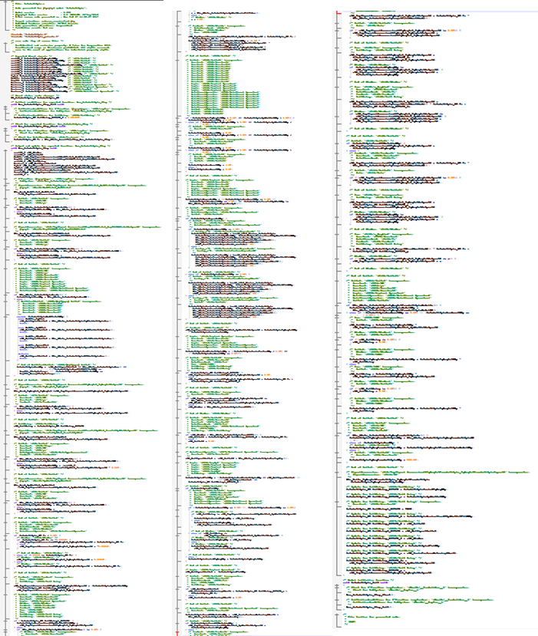
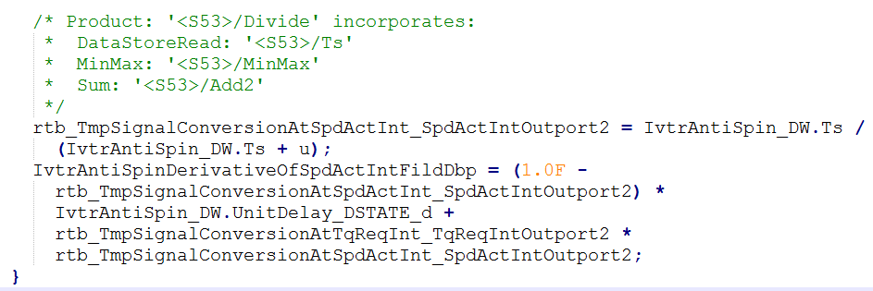
A Propulsion case
In Electric Drive Control:
1 Software component, IvtrAntiSpin has 830 Loc
At line 303 there is a division sign.
Careful testing is required!
Division by zero is fatal
IvtrAntiSpin.c 830 loc

Slide 12

A Bug is Trigged...
Division by zero
The required software update is quite large!
Issue...
Bug fixing...
Several software components require changes
Software update
... and affect signaling to other ECUs.

Slide 13


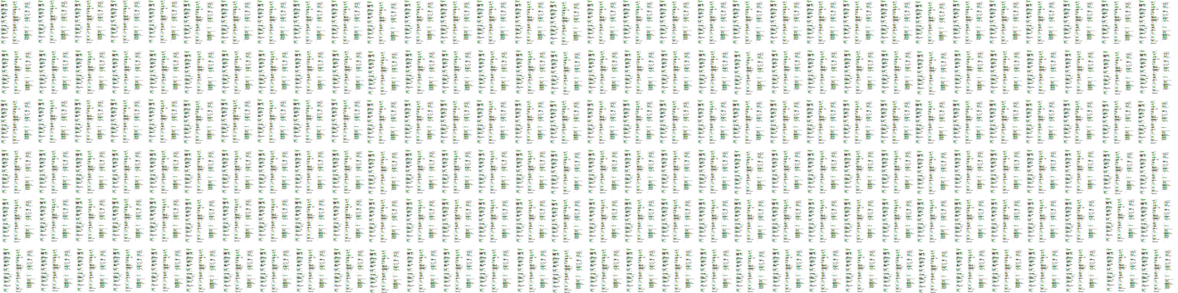
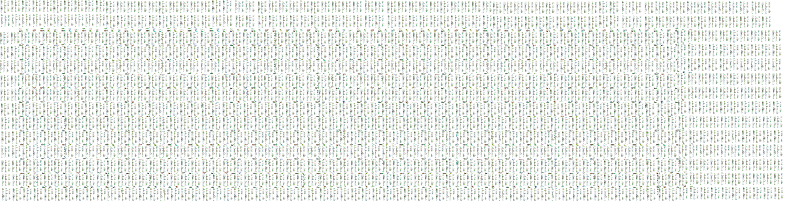
Which Caused a chain reaction...
Software
update
New Issue...
Bug fixing...
Electric Motor Code: 160 000 Loc
Software update
Issue...
Bug fixing...
Issue...
Software update
Bug fixing...
Software update
Combustion motor Code: 800 000 Loc

Slide 14

Propulsion Code, 1 000 000 Loc, 1% of vehicle
Complex software in average
Developed SW: 1 defect / 200 – 3500 loc.
Shipped SW: 1 defect / 10000 loc.
Unmanaged Complexity generates Technical Debt
for which we pay interest rate regularly
Volvo 2020 100 000 000 Loc

Slide 15

Technical debt Explained
Small product
1000 LOC
Total Cost = 50 KSEK
No technical debt!
Invested money for new feature development
Cost of Fixing Bugs

Slide 16

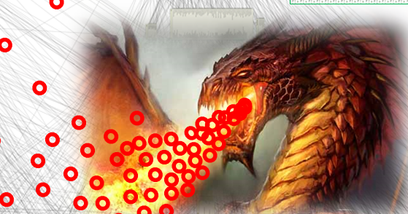
Technical debt explained
Large product
100 000 000 LOC
Total Cost
Essential Complexity Accidental
Cost of mastering the existing complexity to enable new feature addition
Invested money for new feature development
Cost of fixing bugs
Visible
Invisible
Visible
Technical debt - “not quite right software which we postpone making it right”

Slide 17


What to do?
How?
Today: Significant Technical Debt!
Tomorrow: Insignificant Technical Debt!

Slide 18
Enhance code Craftsmanship
Learn to write simple, modular, and readable code
Maintain full traceability to reduce recall time
Code Complexity Characteristics
Accidental characteristics Essential characteristics
Influence on Complexity Increase

Slide 19




Employ Continuous integration and Feedback
CI enables us to continuously have a working product
Find bugs fast, fix them fast!
-enables work with small increments, frequently!
The CI
is a fully automated test machinery
updates
The agile team
needs fast and reliable feedback
Fast Test
feedback!!
Regression
Test feedback
(slower, better)

Slide 20

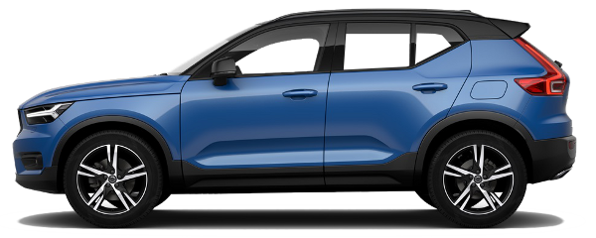
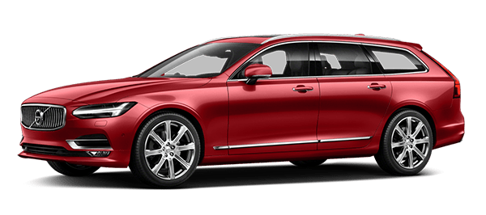
Remove Unworthy Variants
Vehicle Current Variants - Example
Every variant is a complete car
Every variant needs to be crafted continuously to perfection!
Vehicle variant
Engine variant
HP
MP
Emission variant
Europe
China
Russia
USA
South America
Gearbox variant
Forward wheel drive
All wheel drive
XC90
XC60
V90
Increasing variants linearly increases complexity exponentially

Slide 21
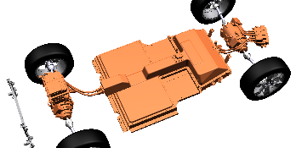
Develo Decoupled Modules and interfaces
Enable:
As independent development as possible
Minimal accidental complexity
Understandable software architecture
Battery Module
Electric Drive
Module
software
software
software
Engine control module
Autonomous Drive
Module
Charging module
Hardware & sensors
Used services
Modules using this service

Slide 22
What do we need? – Manage accidental complexity
Continuously build quality in to reduce Technical Debt and produce greater amount of Value
Total Cost
Only Essential Complexity
Code craftsmanship
Continuous integration
Fast feedback loops
Minimal variants
Well-defined interfaces
...
Invested money for new feature development
Cost of fixing bugs
What generates technical debt? - Not quite right software which we postpone making right

Slide 23

Reflections
Discuss with your neighbor
Have you developed software project that had significant technical debt?
What actions could you take?

Slide 24
Recommended Reading
MISRA 2012 clean coding guidelines
https://www.academia.edu/40301277/MISRA_C_2_012_Guidelines_for_the_use_of_the_C_language_in_critical_systems
Future Automotive Architecture and the Impact of IT Trends
https://assets.vector.com/cms/content/consulting/publications/BMW_Future_Automotive_Architectures.pdf
https://ieeexplore.ieee.org/abstract/document/7927914
Evaluating Essential and Accidental Code Complexity Triggers by Practitioners' Perception
https://www.researchgate.net/publication/339377604_Evaluating_Essential_and_Accidental_Code_Complexity_Triggers_by_Practitioners'_Perception
https://ieeexplore.ieee.org/abstract/document/9007382
Books:
Clean Code, Robert C. Martin

